Slide 1

Module I
Master of Computer Applications
Minor Specialization – Agile Software Development Approaches
Subject code – 23MCAM21
Assistant Professor – Prof. Rahul Pawar
Introduction

Slide 2

Software Engineering
Unit : 1
Software is more than just a program code.
A program is an executable code, which serves some computational purpose.
Software is considered to be collection of executable programming code, associated libraries and documentations.
Software, when made for a specific requirement is called software product.
Engineering on the other hand, is all about developing products, using well-defined, scientific principles and methods.

Slide 3
Unit : 1
Software Is New Product Development
The Agile software development approach is a methodology that emphasizes iterative and collaborative development.
In the context of new product development, Agile is applied to enhance the efficiency and adaptability of the software development process.
The key principles include customer collaboration, responding to change, and delivering functional software in short iterations.

Slide 4
Unit : 1
In Agile, the development process is divided into small, manageable increments called sprints.
Cross-functional teams work closely with stakeholders, including end-users, to gather feedback and make adjustments throughout the development cycle.
This iterative approach allows for flexibility and the incorporation of changes based on evolving requirements.

Slide 5
Unit : 1
Some common frameworks used in Agile product development include Scrum, Kanban and Extreme Programming (XP).
These frameworks provide specific guidelines and roles to facilitate effective collaboration and streamline the development process.
Overall, Agile software development in new product development focuses on customer satisfaction, adaptability to changing requirements, and delivering a product that meets user needs through continuous collaboration and incremental development.

Slide 6
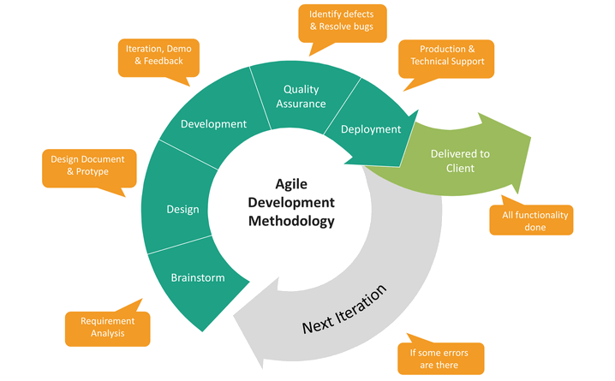
Unit : 1

Slide 7
Unit : 1
Iterative Development
Iterative development is an approach to building software (or anything) in which the overall lifecycle is composed of several iterations in sequence
Each iteration is a self-contained mini-project composed of activities such as requirements analysis, design, programming, and test
The goal for the end of an iteration is an iteration release, a stable, integrated and tested partially complete system

Slide 8
Unit : 1
All the software across all the teams is integrated into a release each iteration
Most iteration releases are internal, a baseline primarily for the benefit of the development team—they are not released externally
The final iteration release is the complete product, released to the market or clients

Slide 9
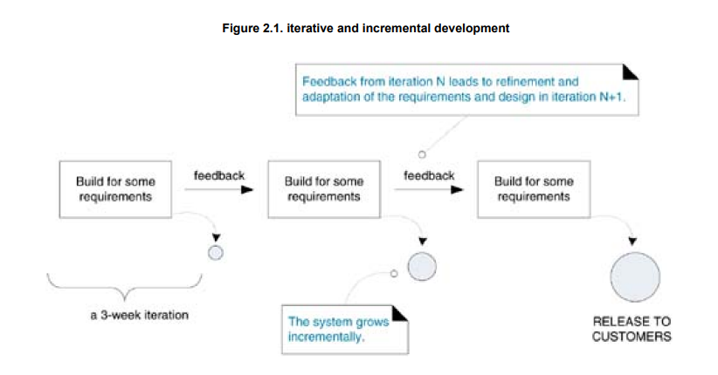
Unit : 1

Slide 10
Unit : 1
Risk-Driven Iterative Planning
Risk-driven iterative development chooses the riskiest, most difficult elements for the early iterations
For example, maybe the client says "I want the Web pages to be green and the system to handle 5,000 simultaneous transactions.“ Green can wait.
In this way, the highest risks are surfaced and mitigated early rather than late

Slide 11
Unit : 1
Risk is a broad concept may be you are making a new 3D modeling tool and market research shows that what will capture market interest is a novel, much easier user interface metaphor
The high risk is not getting the UI right

Slide 12
Unit : 1
Client-Driven Iterative Planning
Client-driven iterative development implies that the choice of features for the next iteration comes from the client whatever they perceive as the highest business value to them
In this way, the client steers the project, iteration by iteration, requesting the features that they currently think are most valuable
Note that the customer adaptively plans the choice for the next iteration, shortly before it starts, based on their latest insight, rather than speculatively at the start of the project

Slide 13
Unit : 1
The customer has ongoing control and choice, as fresh information arises
Apply both schemes
Clients do not always appreciate what is technically hard or risky
Developers do not always appreciate what has high business value

Slide 14
Unit : 1
Time-Boxed Iterative Planning
Iteration timeboxing is the practice of fixing the iteration end date and not allowing it to change
An overall project may be timeboxed as well
If it eventually appears that the chosen requests (the scope) for the iteration can't be met within the timebox, then rather than slip the iteration end date
The scope is reduced (placing lower priority requests back on the wish-list), so that the partial, growing system always ends in a stable and tested state on the original planned iteration end date

Slide 15
Unit : 1

Slide 16
Unit : 1
Time-Boxed Iterative Planning
In most IID methods, not all timebox lengths need be equal
The first iteration may be four weeks, the second
iteration three weeks, and so forth
On the other hand, the Scrum method recommends that each timebox be exactly 30 calendar days
As mentioned, most IID methods recommend an iteration timebox between one and six weeks

Slide 17
Unit : 1
During the Iteration, No Changes
From External Stakeholders
One week into a three-week iteration, the product manager should not come along, and ask, "Can you do this too?"
They wait for the next iteration
However, the team itself can reduce the scope of an iteration if the timebox deadline cannot otherwise be met

Slide 18
Unit : 1
Evolutionary and Adaptive Development
Evolutionary iterative development implies that the requirements, plan, estimates and solution evolve
Or are refined over the course of the iterations, rather than fully defined and "frozen" in a major up-front specification effort before the development iterations begin
Evolutionary methods are consistent with the pattern of unpredictable discovery and change in new product development

Slide 19
Unit : 1
Adaptive development implies that elements adapt in response to feedback from prior work feedback from users, tests, developers and so on
The intent is the same as evolutionary development, but the name suggests more strongly the feedback-response mechanism in evolution
Some methods or methodologists emphasize the term "iterative" while others use "evolutionary" or "adaptive"
The ideas and intent are similar, although strictly speaking, evolutionary and adaptive development does not require the use of timeboxed iterations

Slide 20
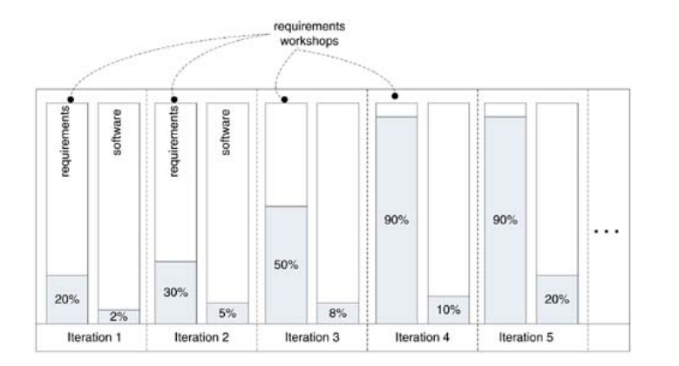
Unit : 1
Evolutionary Requirements Analysis

Slide 21
Unit : 1
In evolutionary and adaptive development, it is not the case that the requirements are forever unbounded or always changing at a high rate
Rather, most requirements discovery and refinement usually occurs during early iterations, and the earliest attention is given to understanding the most architecturally significant or high-business-value requirements
For example, on an ultimately 20-iteration project, it is likely that most requirements will be discovered and refined within the first three or four iterations (that include, in parallel, early software development)

Slide 22
Unit : 1
In each iteration, there is a one or two-day requirements workshop in which the specifications expand and refine, in response to further analysis and feedback from the system under development
For example, the first workshop focuses on detailed analysis of 20% of the most architecturally significant and risky requirements
This gives the software architect enough meaningful input to start development and test in short cycles

Slide 23
Unit : 1
Early “Top 10” High-Level Requirements
and Skillful Analysis
Modern IID (iterative and incremental development) methods encourage the early creation and baselining of vision statements, "top ten" high-level requirements lists
Early analysis of architecturally influential factors, such as load, usability, and internationalization

Slide 24
Unit : 1
Early “Top 10” High-Level Requirements
and Skillful Analysis
Further, these methods encourage many skillful analysis techniques during early iterations, such as a series of requirements workshops involving both target users and developers, writing use cases, and much more

Slide 25
Unit : 1
Early “Top 10” High-Level Requirements
and Skillful Analysis
1. Clearly Define Project Objectives:
Requirement: Clearly articulate the project's overall goals and objectives.
Analysis: Ensure alignment with the organization's strategic objectives. Assess if the objectives are specific, measurable, achievable, relevant, and time-bound (SMART).
2. Stakeholder Identification and Analysis:
Requirement: Identify and list primary stakeholders along with their needs and expectations.
Analysis: Prioritize stakeholders based on influence and interest. Assess potential conflicts and synergies among stakeholders.

Slide 26
Unit : 1
3. Regulatory and Compliance Requirements:
Requirement: Identify and document any legal, regulatory, or compliance requirements relevant to the project.
Analysis: Ensure that the project complies with all applicable laws and regulations. Evaluate potential risks associated with non-compliance.
4. Functional Requirements:
Requirement: Define high-level functionalities the system or product must deliver.
Analysis: Prioritize functions based on criticality to the project objectives. Assess feasibility and potential challenges.

Slide 27
Unit : 1
5. Non-Functional Requirements:
Requirement: Specify performance, security, usability, and other non-functional aspects.
Analysis: Consider trade-offs between different non-functional requirements. Ensure they align with stakeholder expectations.
6. Budget and Resource Constraints:
Requirement: Clearly outline budget constraints and resource limitations.
Analysis: Evaluate the feasibility of the project within the given constraints. Identify potential risks and mitigation strategies.

Slide 28
Unit : 1
7. Project Timeline and Milestones:
Requirement: Define key project milestones and the overall timeline.
Analysis: Assess the feasibility of the timeline. Identify critical path activities and potential bottlenecks.
8. Scalability and Future Expansion:
Requirement: Consider the scalability of the solution and its potential for future expansion.
Analysis: Evaluate the scalability requirements against expected growth. Anticipate future needs and plan for scalability.

Slide 29
Unit : 1
9. Risk Management:
Requirement: Identify potential risks and uncertainties related to the project.
Analysis: Conduct a risk assessment, prioritize risks, and develop mitigation strategies. Evaluate the impact of risks on project success.
10. Communication and Reporting:
Requirement: Define communication channels, reporting frequency, and stakeholders involved in project updates.
Analysis: Ensure effective communication throughout the project. Evaluate reporting mechanisms for transparency and accountability.

Slide 30
Unit : 1
Evolutionary and Adaptive Planning
As with evolutionary requirements, with evolutionary and adaptive planning it is not the case that estimates and schedules are forever unbounded or unknown.
Yet, due to early requirements change and other factors, there is an initial phase of high uncertainty, which drops as time passes and information accumulates.
This has been called the cone of uncertainty

Slide 31
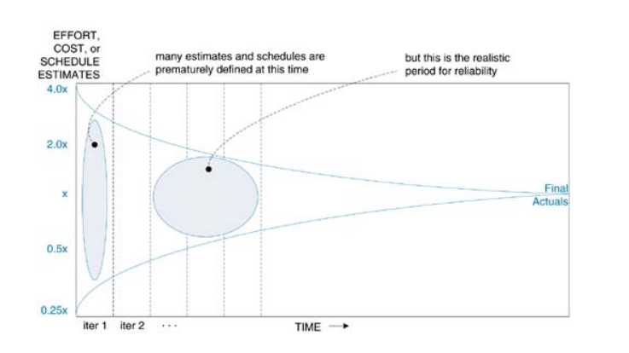
Unit : 1
Evolutionary and Adaptive Planning
Fig. Cone of uncertainty

Slide 32
Unit : 1
Evolutionary and Adaptive Planning
This is consistent with management practice in other new product development domains, where an initial exploratory phase is common.
Further, the practice of adaptive planning is encouraged rather than predictive planning.
That is, a detailed schedule is not created beyond a relatively short time horizon, so that the level of detail and commitment is commensurate with the quality of information.

Slide 33
Unit : 1
Incremental Delivery
Incremental delivery is the practice of repeatedly delivering a system into production (or the marketplace) in a series of expanding capabilities.
The practice is promoted by IID and agile methods. Incremental deliveries are often between three and twelve months.
Incremental delivery is often confused with iterative development.

Slide 34
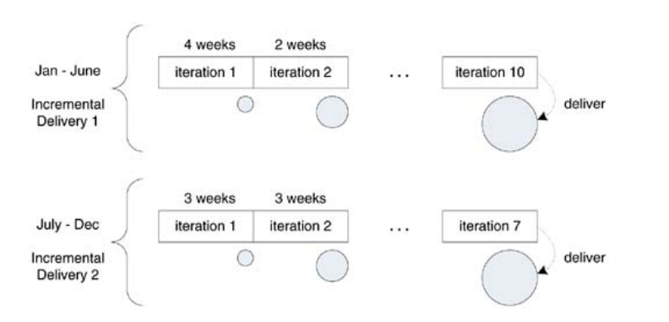
Unit : 1
Incremental Delivery
A six-month delivery cycle could be composed of 10 short iterations.
The results of each iteration are not delivered to the marketplace, but the results of an incremental delivery are.

Slide 35
Unit : 1
Evolutionary Delivery
Evolutionary delivery is a refinement of the practice of incremental delivery in which there is a vigorous attempt to capture feedback regarding the installed product, and use this to guide the next delivery.
Naturally, the evolutionary goal is to best meet some difficult-to-predict need, such as the most frequently requested new features.
Uniquely, the Evo method promotes when possible every short evolutionary delivery cycles of one or two weeks, so that each iteration delivers something useful to stakeholders.

Slide 36
Unit : 1
The Most Common Mistake
This profound misunderstanding, still superimposing waterfall-inspired, big up-front analysis and planning (predictable manufacturing) values onto iterative methods, is one of the most common mistakes that new iterative and agile method adopters make.
Iterative and agile process coaches often see scenarios where the iteration model having imbibed the properties of Waterfall model indirectly, changing the schedule as it may look iterative in nature although its not practically

Slide 37
Unit : 1
Specific Iterative & Evolutionary Methods
This section mentions some iterative methods (Evo and UP) that predate most agile methods; they may or may not be considered agile.
Evo
It was perhaps the first iterative and evolutionary
method, starting in the 1960s.
Evo recommends short 12 week iterations, and uniquely, evolutionary delivery each iteration.

Slide 38
Unit : 1
Evo adaptively plans iterations by highest value to-cost ratio, and strongly promotes the unambiguous definition of quality requirements (such as load) with quantified and measurable statements.
2. Unified Process
The UP or RUP, first developed in the mid-1990s, brings together the knowledge of many experienced large-system architects and process-leaders at Rational Corp., and their customers, into a well-defined IID method.

Slide 39
Unit : 1
One key UP theme is risk-driven development in the early iterations, focusing on creation of the core architecture and driving down the high risks.
The UP also includes the definition of common project work products, such as the Vision, Software Architecture Document, and Risk List.

Slide 40


